Slide 1
RBAC
Access depends on function, not identity
Example:
Allison, bookkeeper for Math Dept, has access to financial records.
She leaves.
Betty hired as the new bookkeeper, so she now has access to those records
The role of “bookkeeper” dictates access, not the identity of the individual.

Slide 2
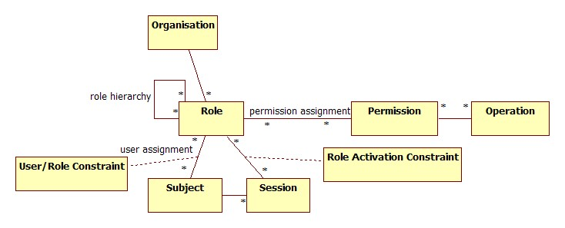

Slide 3
RBAC96 model (Currently foundation of a NIST/ANSI/ISO standard)
ROLE HIERARCHIES
USER-ROLE
ASSIGNMENT
PERMISSIONS-ROLE
ASSIGNMENT
USERS
ROLES
PERMISSIONS
CONSTRAINTS
...
SESSIONS

Slide 4
EXAMPLE ROLE HIERARCHY
Director (DIR)
Project Lead 1
(PL1)
Project Lead 2
(PL2)
Production 1
(P1)
Quality 1
(Q1)
Production 2
(P2)
Quality 2
(Q2)
Engineer 1
(E1)
Engineer 2
(E2)
PROJECT 1
Engineering Department (ED)
PROJECT 2
Employee (E)

Slide 5
EXAMPLE ROLE HIERARCHY
Project Lead 1
(PL1)
Project Lead 2
(PL2)
Production 1
(P1)
Quality 1
(Q1)
Production 2
(P2)
Quality 2
(Q2)
Engineer 1
(E1)
Engineer 2
(E2)
PROJECT 1
Engineering Department (ED)
PROJECT 2
Employee (E)

Slide 6
Definitions
Role r: collection of job functions
trans(r): set of authorized transactions for r
Active role of subject s: role s is currently in
actr(s)
Authorized roles of a subject s: set of roles s is authorized to assume
authr(s)
canexec(s, t) iff subject s can execute transaction t at current time

Slide 7
Axioms
Let S be the set of subjects and T the set of transactions.
Rule of role assignment:
(∀s ∈ S)(∀t ∈ T) [canexec(s, t) → actr(s) ≠ ∅].
If s can execute a transaction, it has a role
This ties transactions to roles
Rule of role authorization:
(∀s ∈ S) [actr(s) ⊆ authr(s)].
Subject must be authorized to assume an active role (otherwise, any subject could assume any role)

Slide 8
Axiom
Rule of transaction authorization:
(∀s ∈ S)(∀t ∈ T) [canexec(s, t) → t ∈ trans(actr(s))].
If a subject s can execute a transaction, then the transaction is an authorized one for the role s has assumed

Slide 9
Containment of Roles
Trainer can do all transactions that trainee can do (and then some). This means role r contains role r′ (r > r′). So:
(∀s ∈ S)[ r′ ∈ authr(s) ∧ r > r′ → r ∈ authr(s) ]

Slide 10
Separation of Duty
Let r be a role, and let s be a subject such that r ∈ auth(s). Then the predicate meauth(r) (for mutually exclusive authorizations) is the set of roles that s cannot assume because of the separation of duty requirement.
Separation of duty:
(∀r₁, r₂ ∈ R) [ r₂ ∈ meauth(r₁) →
[ (∀s ∈ S) [ r₁∈ authr(s) → r₂ ∉ authr(s) ] ] ]

Slide 11
Safety in Access Control
Authentication
who is trying to access a protected resource?
Access Control Models
Access Control Architecture
Authorization
Enforcement
who should be allowed to access which protected resources?
who should be allowed to change the access?
how does the system enforce the specified authorization
The Safety Problem

Slide 12
ACCESS-CONTROL ARCHITECTURE SERVER-PULL
Client
Server
Authorization
Server
Authentication
Server

Slide 13
ACCESS-CONTROL ARCHITECTURE USER-PULL
Client
Server
Authorization
Server
Authentication
Server

Slide 14
ACCESS-CONTROL ARCHITECTURE PROXY-BASED
Client
Proxy
Server
Authentication
Server
Authorization
Server

Slide 15
Key Points
Hybrid policies deal with both confidentiality and integrity
Different combinations of these
ORCON model neither MAC nor DAC
Actually, a combination
RBAC model controls access based on functionality

Slide 16
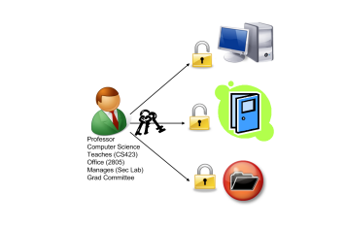
User Attributes

Slide 17
Attribute Based Management
Attribute based encryption (ABE)
Identity management
Usage control
Attribute Based Access Control (ABAC)

Slide 18

Attribute Administration
In each organization, certain administrators have to assign user attributes values when the user is provisioned and modify user attributes values thereafter.
Attributes of the same user constrain each other.
Administration rules are specified to regulate attribute modifications

Slide 19
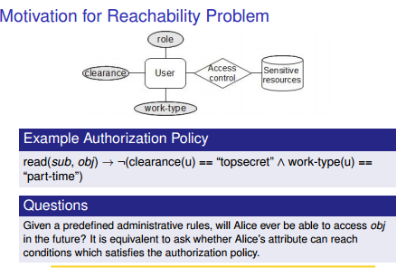
Sandhu

Slide 20
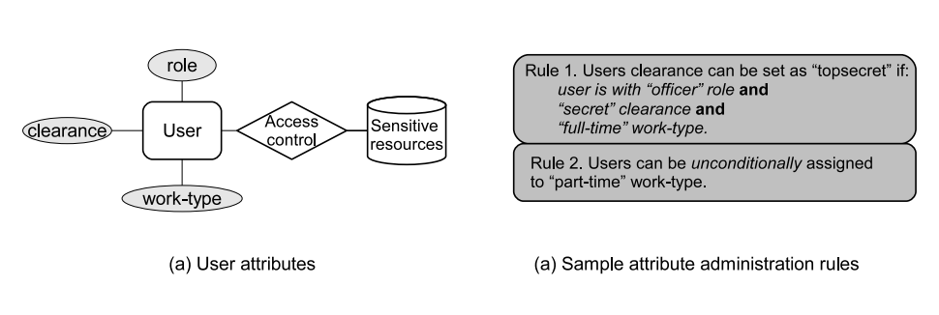
It might seem that a user can never be “part time”
and with “topsecret” clearance at the same time
The policy may inadvertently allow that
A user may be “full time” and then assigned to “topsecret”
clearance according to rule 1.
After that, he can be assigned to
“part time” work-type according to rule 2.

Slide 21
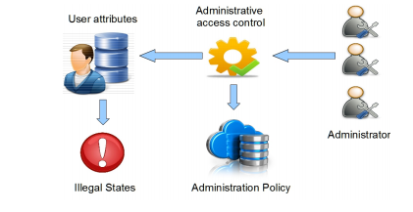
Reachability Issues

Slide 22
References
Matt Bishop -- see course details
David E. Bell: Looking Back at the Bell-La Padula Model
Ross Anderson
Alexander Brodsky, Csilla Farkas, and Sushil Jajodia ,Database Security—Concepts,Approaches, and Challenges
IEEE TRANSACTIONS ON DEPENDABLE AND SECURE COMPUTING. JANUARY-MARCH 2005 http://ieeexplore.ieee.org/servlet/opac?punumber=8858

